Slide 1

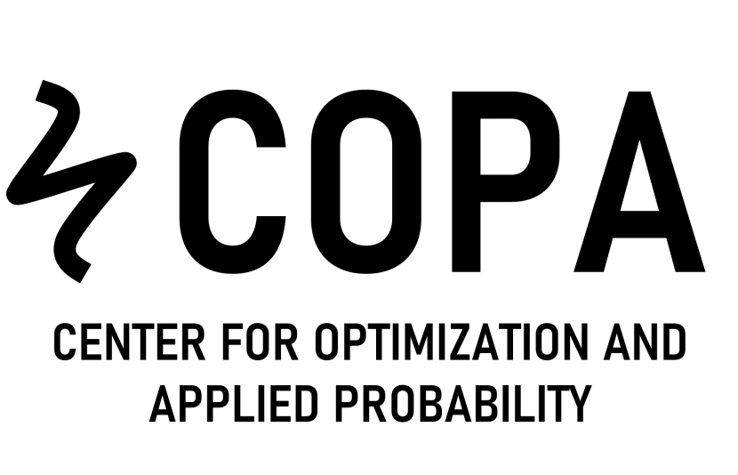
Stochastic optimization for the purchasing inventory routing problem in agri-food supply chains
Ariel Rojas, Juan Betancourt,
Daniel Cuellar, Marlin Ulmer,
Camilo Gómez, David Álvarez Martínez
Decision Analytics Lab

Slide 2




Suppliers - Farmers
Warehouse
Customers

Slide 3


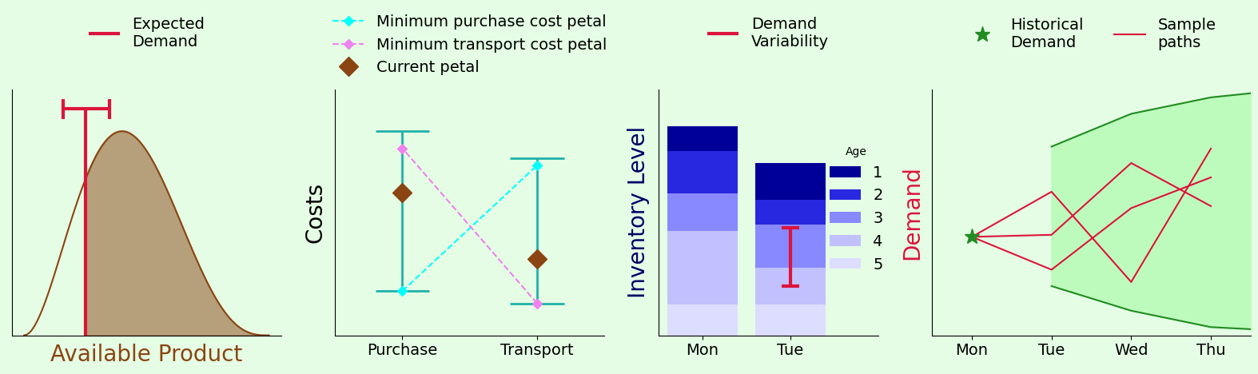
Suppliers - Farmers
Warehouse
Customers

Slide 4


Suppliers - Farmers
Warehouse
Customers

Slide 5


Suppliers - Farmers
Warehouse
Customers

Slide 6
Suppliers - Farmers
Warehouse
Customers

Slide 7
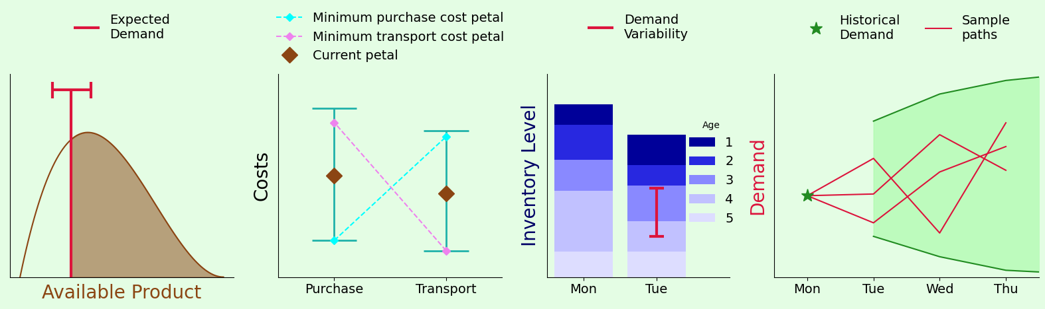
Suppliers - Farmers
Warehouse
Customers

Slide 8



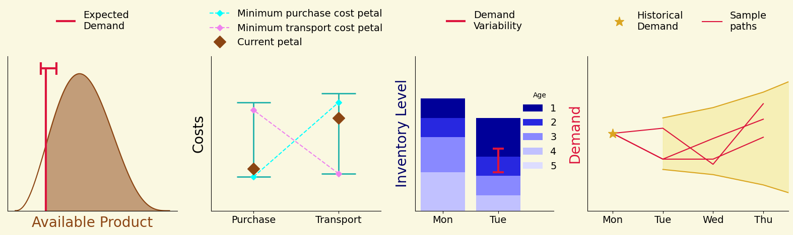
Suppliers - Farmers
Warehouse
Customers

Slide 9





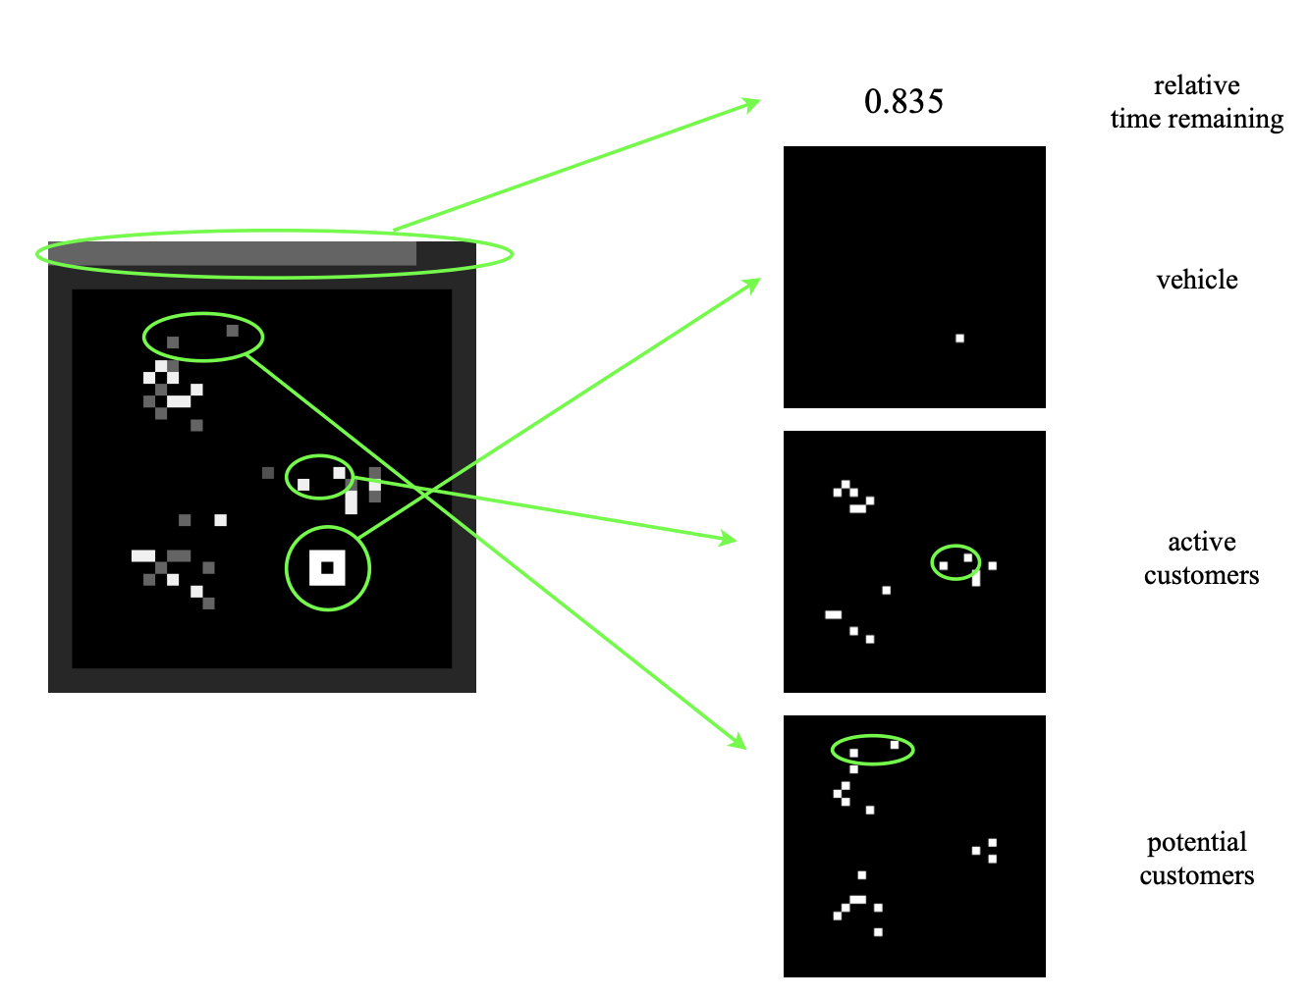
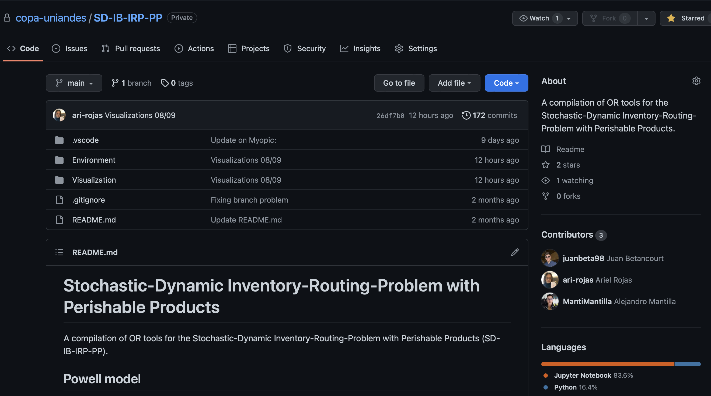
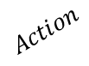
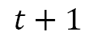
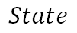
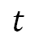
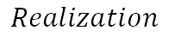
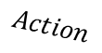
Suppliers - Farmers
Warehouse
Customers
$$t$$
$$t+1$$
$$Action$$
$$Action$$
$$State$$
$$Realization$$
$$State$$
$$Realization$$

Slide 10
Suppliers - Farmers
Warehouse
Customers
Historical Data
Stochastic Modeling $(W_{t})$
Historical Data
Availabilities & prices
Availability
(Price and transportation)
Demand
Estimations
Demand
System Dynamics $(S_{t},S_{X}^{M})$
Inventory of perishable products, updated with the
purchasing and collection of products throughout suppliers
in response to the demand.

Slide 11
Suppliers - Farmers
Warehouse
Customers
Routing Policy
Purchasing Policy
Inventory Policy
Delivery Policy
MIP/LP Rolling Horizon
Column Generation
Split
Metaheuristics

Slide 12
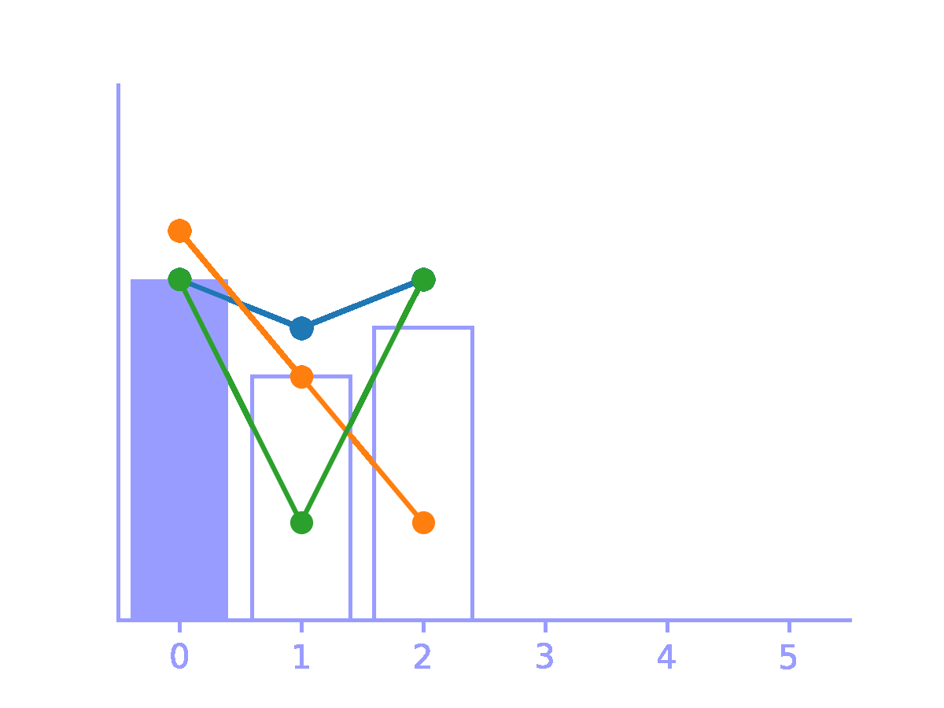
Suppliers - Farmers
Warehouse
Customers
Time Period
Time Period
Quantity
Costs

Slide 13
Thank you
Decision Analytics Lab

